Slide 1


Green Pace
Security Policy Presentation
Developer: Grant Manley

Slide 2


OVERVIEW: DEFENSE IN DEPTH
Company growth calls for standardization of security practices throughout the SDLC.
Input validation, memory handling, authentication, authorization, testing and more require consistent implementation across all areas of development.
Defense-in-depth depends on consistent implementation of security principles and controls.
Establish multiple layers of prevention, detection, and mitigation.
Notes:
As projects and development teams grow, the need for consistent implementation of security practices throughout the software development lifecycle is important. Setting universal standards and expectations for input validation, handling memory, authentication, authorization, and testing will promote consistent security practices across all areas of development. Our principles and standards establish multiple layers of prevention, detection, and mitigation supporting a defense-in-depth strategy the strengthens security and builds client trust.
An example of this strategy is the team’s consistent usage of STD-004-CPP which is the sanitization of data passed to complex subsystems. Through consistent usage of parameterized queries, we can prevent untrusted values from being mishandled and interpreted as SQL instructions. By implementing restrictive least-privilege databases we limit the database operations an account can perform, reducing potential damage if an account or application is compromised. Additionally, through security logging of users and database activity we can identify suspicious activity in detail and support investigation and incident response.

Slide 3
THREATS MATRIX
Likely STD-007-CPP STD-009-CPP | Priority STD-001-CPP STD-002-CPP STD-003-CPP STD-004-CPP STD-005-CPP STD-008-CPP
Low priority None Identified | Unlikely STD-006-CPP STD-010-CPP
Notes:
As you can see on this slide we’ve identified six coding standards to be of priority, with only two falling into each of the likely and unlikely categories. Starting in the bottom right corner we have two principles classified as high priority yet unlikely, STD-006-CPP (Understand the termination behavior of assert() and abort(), and STD-010-CPP (Do not use std::rand() for generating pseudorandom numbers (MSC50-CPP).
STD-006-CPP explanation/summary: Assertions when properly used detect violations of assumptions and can highlight programming errors. Assertions should not be used as validation for runtime inputs, and instead more thorough validation techniques should be in place. Since assertions can be disabled, validation critical to the software’s security should not be operated by an assert().
STD-010-CPP explanation/summary: Using std::rand() for randomization of numerical values has a lower quality and higher predictability of generated values than the <random> library which has a separate engine for value distribution based on the input range.
In the top left corner of the matrix, we have classified STD-007-CPP, handle all exceptions (ERR51-CPP), and STD-009-CPP, Close files when they are no longer needed (FIO51-CPP), both as likely and medium priority.
STD-007-CPP explanation/summary: Proper handling of errors and exceptions allows detection of abnormal conditions and allows engineers to signify how the program will handle them. If exception handling is not in place, programs will behave unexpectedly and lead to crashes and termination. Expected exceptions that may occur require the appropriate handling, and often a try/catch statement will provide the necessary capability.
STD-009-CPP explanation/summary: Opening files allocate resources and therefore should be closed when they are no longer in use. This practice will prevent unnecessary resource drain and ensure file buffers are properly flushed.
Our largest matrix grouping is high priority and very likely. We’ll address these one at a time starting with:
STD-001-CPP explanation/summary: Ensure that unsigned integer operations do not wrap (INT30-C). Unsigned integers have a fixed range which cannot represent negative numerical values less than zero or greater than the data type’s maximum. Exceeding either of these will result in wrapping, for instance if the value is less than zero, it will wrap to the maximum value and continue decreasing from there, causing unexpected behavior within the program.
STD-002-CPP explanation/summary: Detect errors when converting a string to a number (ERR34-C). When extracting and converting values from string objects, checking for errors will prevent invalid or mismatched data from being accepted and causing unexpected behavior. Validation must be in place to check for acceptable data types and ensure proper conversion is being executed within the range of the container object’s data type.
STD-003-CPP explanation/summary: Guarantee that storage for strings has sufficient space for character data and the null terminator (STR50-CPP). C-style strings must be stored into character arrays and require room for a null terminator ‘\0’ at the end. If string size versus allocated buffer/array size is not checked, buffer overflow can occur leading to unexpected behavior, corrupted data, overwritten memory, and other errors.
STD-004-CPP explanation/summary: Sanitize data passed to complex subsystems (STR02-C). Input often comes through untrusted sources, and appropriate validation handling should be in place based on the subsystem in use. In the case of SQL databases user input values should be properly separated from actual SQL syntax by use of parameterized statements so user input data is not interpreted as an SQL command opening the door to SQL injection and malicious or unexpected behavior.
STD-005-CPP explanation/summary: Do not access freed memory (MEM50-CPP). Dynamically allocated memory through usage of pointers must be released, modern C++ smart pointers provide this functionality automatically. After the memory is deallocated, the object stored at said address is no longer valid or accessible. Pointers for memory that have been deallocated create dangling pointers and can lead to exploitable vulnerabilities.
STD-008- explanation/summary: Do not read uninitialized memory (EXP53-CPP). Attempting to access an object or variable that has not been assigned any value can lead to unexpected behavior. Variables should be initialized with a meaningful value before any further code attempts to access them.

Slide 4
10 PRINCIPLES
Validate Input Data: STD-002, STD-003, STD-004
Heed Compiler Warnings: STD-001, STD-002, STD-008
Architect and Design for Security Policies: STD-003, STD-004, STD-005
Keep it Simple: STD-002, STD-007
Default Deny: STD-004, STD-005
Adhere to the Principle of Least Privilege: STD-004, STD-005
Sanitize Data Sent to Other Systems: STD-004
Practice Defense in Depth: STD-003, STD-004, STD-005, STD-008
Use Effective Quality Assurance Techniques: STD-001 – STD-010
Adopt a Secure Coding Standard: STD-001 – STD-010

Slide 5
CODING STANDARDS
Standard | Severity | Likelihood | Remediation Cost | Priority | Level
STD-001 | High | Likely | Low | High | 4
STD-002 | High | Likely | Low | High | 4
STD-003 | High | Likely | Medium | High | 5
STD-004 | High | Likely | Medium | High | 5
STD-005 | High | Likely | Medium | High | 5
STD-006 | High | Possible | Low | High | 4
STD-007 | Medium | Likely | Medium | High | 3
STD-008 | High | Likely | Low | High | 4
STD-009 | Medium | Likely | Low | Medium | 3
STD-010 | High | Possible | Low | High | 4

Slide 6
ENCRYPTION POLICIES
Encryption policy | Green Pace implementation | Purpose
At Rest | AES-256 encryption; separate encryption-key storage | Protect stored files, databases, and sensitive information
In Flight | HTTPS with TLS 1.3 | Protect data traveling between clients and servers
In Use | Trusted execution environments, access controls, secure memory management | Protect sensitive information while actively being processed

Slide 7
TRIPLE-A POLICIES
Component | Green Pace implementation | Purpose
Authentication | Multifactor authentication, Active Directory, secure LDAP (LDAPS) | Verify user identities
Authorization | Role-based access control, least privilege, default deny | Restrict access to authorized resources
Accounting | Audit logs of logins, access changes, database modifications, and file access | Track activity and support security investigations

Slide 8
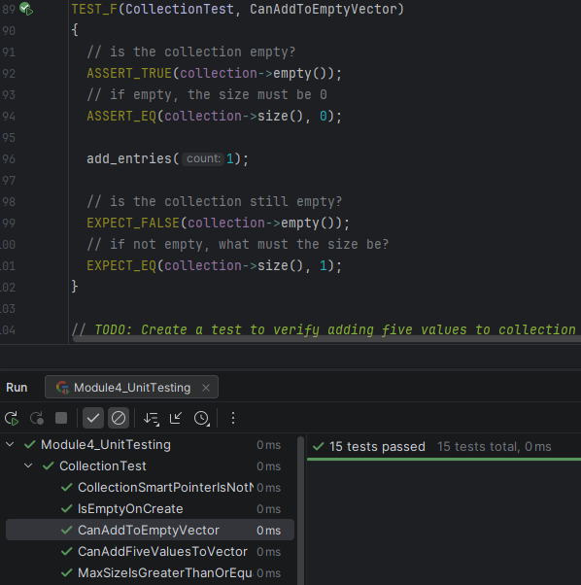
Unit Testing
Can an Element Be Added to an Empty Collection?
Framework: Google Test (TEST_F fixture)
Security Principle: Use Effective Quality Assurance Techniques
Objective: Verify successful insertion into an empty vector.
Assertions: ASSERT_TRUE, ASSERT_EQ, EXPECT_FALSE, EXPECT_EQ
Result: Passed - Vector size increased from 0 to 1.
Further testing: Verify the inserted value is correct, not just the collection size.

Slide 9
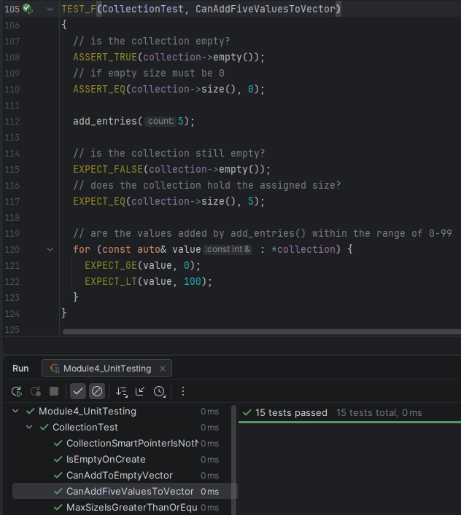
Unit Testing
Can Five Elements Be Added Within the Expected Value Range?
Framework: Google Test (TEST_F fixture)
Security Principle: Validate Input Data
Objective: Verify that five elements can be added to an empty vector and that their values remain within the expected range.
Assertions: ASSERT_TRUE, ASSERT_EQ, EXPECT_FALSE, EXPECT_EQ, EXPECT_GE, EXPECT_LT
Result: Passed - Five elements added, with values between 0 and 99.
Further testing: Test larger collections and boundary values to verify that size and value constraints remain satisfied.

Slide 10
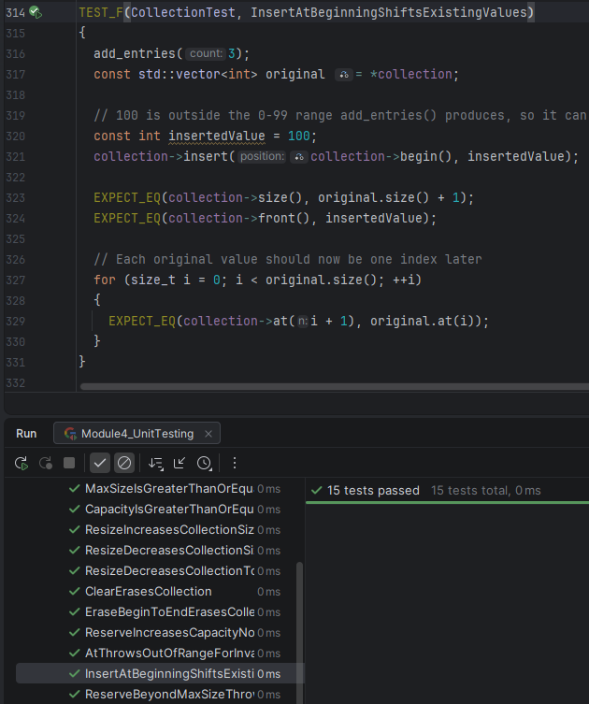
Unit Testing
Can an Element Be Inserted Without Losing Existing Data?
Framework: Google Test (TEST_F fixture)
Security Principle: Use Effective Quality Assurance Techniques
Objective: Verify that inserting a new element at the beginning of a vector preserves the existing elements and their order.
Assertions: EXPECT_EQ
Result: Passed - Inserted value appears first, vector size increases by one, existing values remained intact.
Further testing: Test insertion into an empty vector and insertion at the end to verify correct behavior across different positions.

Slide 11
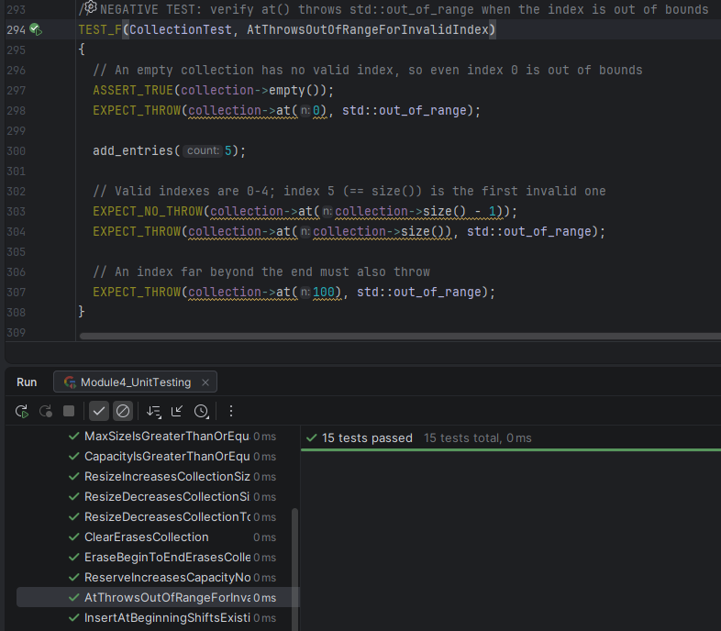
Unit Testing
Does an Invalid Collection Index Trigger an Out-of-Range Exception?
Framework: Google Test (TEST_F fixture)
Security Standard: STD-007 - Exception handling
Objective: Verify that accessing an invalid vector index using at() throws a std::out_of_range exception.
Assertions: ASSERT_TRUE, EXPECT_THROW, EXPECT_NO_THROW
Result: Passed – Invalid indices triggered the expected exception, while a valid index did not.
Further testing: Test additional boundary indices and verify that the collection remains unchanged after an invalid access attempt.

Slide 12
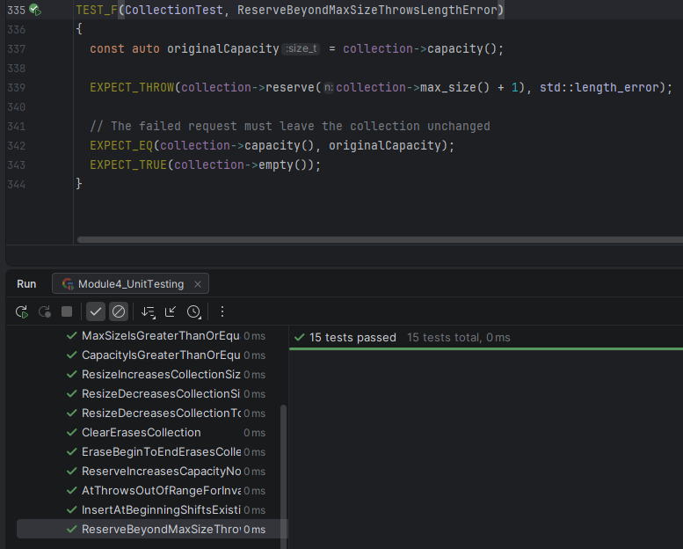
Unit Testing
Does an Excessive Capacity Request Trigger a Length Error?
Framework: Google Test (TEST_F fixture)
Security Standard: STD-007 - Exception Handling
Objective: Verify that requesting capacity beyond a vector’s max_size() throws a std::length_error exception.
Assertions: EXPECT_THROW, EXPECT_EQ, EXPECT_TRUE
Result: Passed – The excessive capacity request triggered the expected exception, and the collection remained unchanged.
Further testing: Test valid capacity requests and boundary conditions without attempting impractically large allocations.

Slide 13
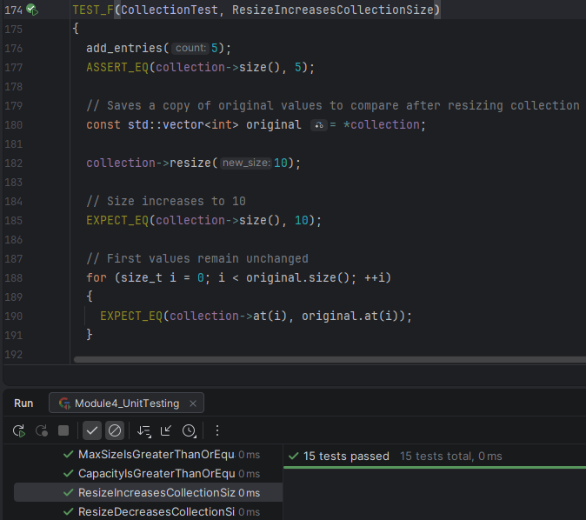
Unit Testing
Can a Vector Be Resized Without Losing Existing Values?
Framework: Google Test (TEST_F fixture)
Security Principle: Use Effective Quality Assurance Techniques
Objective: Verify that increasing a vector’s size preserves the existing values and initializes new elements correctly.
Assertions: ASSERT_EQ, EXPECT_EQ
Result: Passed – Vector size increased from 5 to 10, existing values were preserved, new elements were initialized to zero.
Further testing: Test resizing to smaller size and to zero, verifying remaining values are preserved and removed elements no longer accessible.

Slide 14

AUTOMATION SUMMARY

Slide 15
TOOLS
  Development, Security, and Operations (DevSecOps)
  An approach to the SDLC that integrates security, testing, and automation across all phases of development.
  Tools
  Cppcheck – Through static analysis can detect potential C++ errors, unsafe operations, and coding-standard violations.
  Visual Studio Code Analysis – Static analysis by way of compiler-integrated warnings and security related diagnostics.
  Google Test – Unit testing that automates positive and negative C++ tests through assertions.
  CMake / CLion – Build and test, configures, compiles, and executes existing C++ projects.
  CI/CD platform – Pipeline orchestration to automatically run checks when developers submit code changes. Reports failures and can block deployment until issues are resolved.

Slide 16
RISKS AND BENEFITS
Problems | Solutions | Act Now | Wait
Inconsistent security practices | Enforce coding standards | Earlier detection | Lower immediate costs
Undetected vulnerabilities | Integrate automated testing | Lower long-term remediation costs | Continued exposure
Limited testing coverage | Combine analysis tools | Improved reliability | Costlier future fixes
Late defect discovery | Train developers | Upfront costs and training | Potential security incidents

Slide 17
RECOMMENDATIONS
Potential gap | Why it matters | Recommended improvement
Limited enforcement procedures | Standards alone don’t ensure developer compliance | Require code reviews, automated checks, and documented exceptions
Incomplete security testing coverage | Unit tests and static analysis can’t identify every vulnerability | Add dynamic analysis and integration testing
Insufficient vulnerability management detail | Identifying vulnerabilities is not enough without a process in place to fix them | Define severity thresholds, remediation deadlines, and retesting requirements
Third-party dependency security | Vulnerabilities may exist in libraries even when Green Pace’s own code follows its standards | Introduce dependency scanning and software supply chain controls
Supporting frameworks: (Souppaya et al., 2022; OWASP Foundation, n.d., 2025)

Slide 18
CONCLUSIONS
Additional Recommended Standards and Frameworks for adoption
Standard/Framework | Purpose
NIST Secure Software Development Framework (SSDF) | Formalize secure development, vulnerability response, and continuous improvement
OWASP ASVS | Establish verifiable security requirements for web applications
CERT C/C++ Coding Standards | Maintain and expand the existing ten coding standards as new vulnerabilities arise
NIST SP 800-53 | Provide a broader catalog of security and privacy controls, selected according to Green Pace’s risks
Sources: (Souppaya et al., 2022; OWASP Foundation, 2025; Software Engineering Institute, 2017; Joint Task Force, 2020)

Slide 19
REFERENCES
Joint Task Force. (2020). Security and privacy controls for information systems and
organizations (NIST Special Publication 800-53, Revision 5). National Institute of
Standards and Technology. https://doi.org/10.6028/NIST.SP.800-53r5
OWASP Foundation. (2025). OWASP application security verification standard
(Version 5.0.0). https://github.com/OWASP/ASVS/tree/master/5.0
OWASP Foundation. (n.d.). OWASP software component verification standard.
https://owasp.org/projects/software-component-verification-standard/
Software Engineering Institute. (2017, March 14). SEI CERT C++ coding standard: Rules for
developing safe, reliable, and secure systems (2016 edition). Carnegie Mellon
University. https://www.sei.cmu.edu/library/sei-cert-c-coding-standard-rules-for
-developing-safe-reliable-and-secure-systems-2016-edition-2/
Souppaya, M., Scarfone, K., & Dodson, D. (2022). Secure software development
framework (SSDF) version 1.1: Recommendations for mitigating the risk of
software vulnerabilities (NIST Special Publication 800-218). National Institute of
Standards and Technology. https://doi.org/10.6028/NIST.SP.800-218

